Slide 1
ADVANCED DATA STRUCTURES
By
K. Govindaraju
Associate Professor
Dept. of Computer Science and Engineering
Aditya Engineering College(A)
Surampalem

Slide 2
  Course Objectives:
  Course Outcomes:
  At the end of the Course, Student will be able to:
COB 1: | To make the students learn External Sorting and Hashing Techniques.
COB 2: | To impart the knowledge on Priority Queues.
COB 3: | To provide knowledge on Efficient Binary Search trees and Multiway Search Trees.
COB 4: | To enable the students know the significance of Digital Search Trees.
COB 5: | To facilitate the students learn String Processing Algorithms.
CO 1: | Demonstrate the External Sorting and Hashing.
CO 2: | Illustrate the concepts of Priority Queues.
CO 3: | Analyze the Efficient Binary Search trees and Multiway Search Trees.
CO 4: | Compare the Digital Search Structures.
CO 5: | Apply the String Matching Algorithms to real time applications.
K. Govindaraju, Associate Professor

Slide 3
SYLLABUS
Unit I:
External Sorting: Introduction, K-way Merge Sort, Buffer Handling for parallel Operation, Run Generation, Optimal Merging of Runs, Huffman Tree.
Hashing: Introduction to Static Hashing, Hash Tables, Hash Functions, Different Hash Functions, Collision Resolution Techniques, Dynamic Hashing.
Unit II:
Priority Queues (Heaps): Introduction, Binary Heaps-Model and Simple Implementation, Basic Heap Operations, Other Heap Operations, Applications of Priority Queues, Binomial Heaps (or Queues), Binomial Heap Structure and Implementation, Binomial Queue Operations.
Unit III:
Efficient Binary Search Trees: Self-balancing Binary Search Tree, AVL Trees, Rotations-LL, RR, LR and RL, Searching, Insertion, Deletion operations on AVL Trees, Red-Black Tree, Properties and Representation of Red-Black Trees, Insertion and deletion operations on Red-Black Trees, Applications of Red-Black Trees
K. Govindaraju, Associate Professor

Slide 4
Unit IV:
Multiway Search Trees: M-Way Search Trees Definition and Properties, B-Tree Definition and Properties, Searching, Insertion and Deletion operations on B-Trees, B+ Tree, Insertion and Deletion operations on B+ Trees.
Digital Search Structures: Introduction to Digital Search Tree, Operations on Digital Search Trees- Insertion, Searching, and Deletion.
Unit V:
Digital Search Structures: Binary Tries, Compressed Binary Trie, Patricia, Searching Patricia, inserting into Patricia, delete a node from Patricia, Multiway Tries- Definition, Searching a Trie, Compressed Tries, Compressed Tries with Digit Numbers-Searching, Insertion, Deletion.
String Processing: String Operations, Brute-Force Pattern Matching, The Boyer-Moore Algorithm, The Knuth-Morris-Pratt Algorithm, The Longest Common Subsequence Problem (LCS).
K. Govindaraju, Associate Professor

Slide 5
Text Books:
1. | Advanced Data Structures, Reema Thareja, S. Rama Sree, Oxford University Press.
2. | Data Structures and Algorithm Analysis in C, Mark Allen Weiss, Second Edition, Pearson.
Reference Books:
1. | Fundamentals Of Data Structures In C, Horowitz, Sahni, Anderson-Freed, Second edition.
2. | Data Structures and Algorithms, A. V. Aho, J. E. Hopcroft, and J. D. Ullman, Pearson.
3. | Introduction to Algorithms, Thomas H. Cormen, Charles E. Leiserson and Ronald L. Rivest, Third Edition, The MIT Press.
4. | Advanced Data Structures, Peter Brass, Cambridge University Press.
K. Govindaraju, Associate Professor

Slide 6
External Sorting
The term sorting means arranging the elements of an array in either ascending or descending order.
There are two types of sorting:
  Internal sorting and
  External sorting.
Internal sorting is concerned with the ordering of elements present in a file stored in computers memory.
Eg:Bubble Sort, Insertion Sort, Selection Sort, Heap Sort, Quick Sort, Merge Sort and Radix Sort.
External sorting is applied when there is voluminous data to be sorted that cannot fit in the memory.
Because of their large volumes, the files are stored in external storage devices like magnetic tapes, magnetic disks etc
K. Govindaraju, Associate Professor

Slide 7
The files present on the disk are read into the internal memory in terms of blocks, one block at a time.
The block of records stored in internal memory are sorted making use of any of the existing internal sorting techniques.
Each of the sorted block of records is called as a run.
The file is viewed as a collection of runs.
The runs are written on to the external storage devices as and when required.
The most popular method for sorting files on external storage devices is External Merge Sort also called as K-way merge sort.
K. Govindaraju, Associate Professor

Slide 8
K- WAY MERGE SORT
External merge sort is performed in two phases.
The first phase involves the run generation and the second phase involves the merging of runs to form a larger run.
This run generation is repeated and merging is continued till a single run is generated with the sorted file as its outcome.
If k runs are merged at a time, the external merge sort is called as a k-way Merge Sort.
The k-Way merge sort where k=2 is a 2-way merge sort.
In 2 – Way merge sort, 2 runs are merged at a time to generate a single run twice as long.
The merging process is repeated until a single run is generated.
Eg.: Consider 6000 records are to be sorted and memory can hold 500 records.
K. Govindaraju, Associate Professor

Slide 9
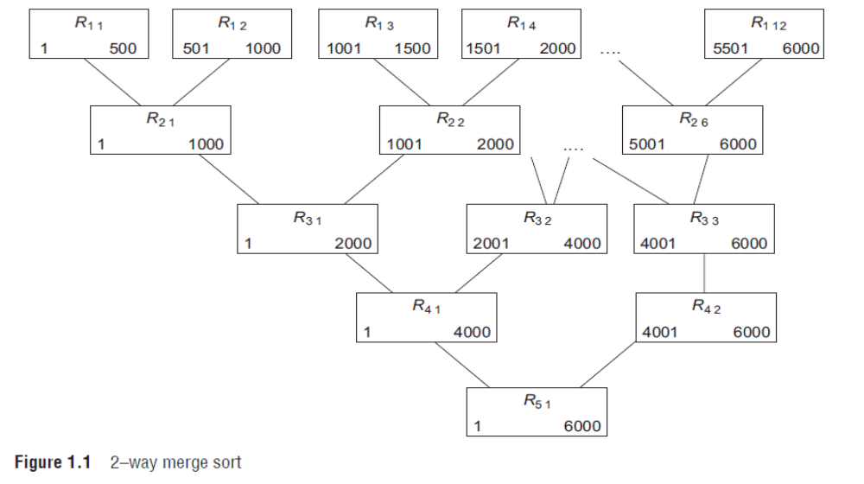
2-WAY MERGE SORT
K. Govindaraju, Associate Professor

Slide 10
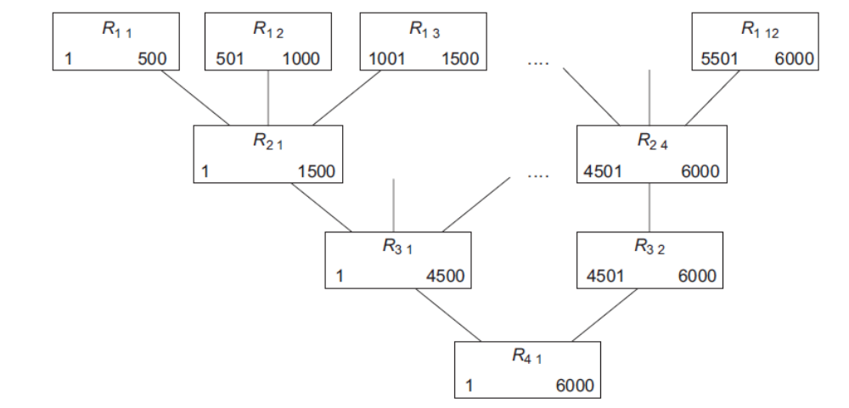
3-WAY MERGE SORT
K. Govindaraju, Associate Professor

Slide 11
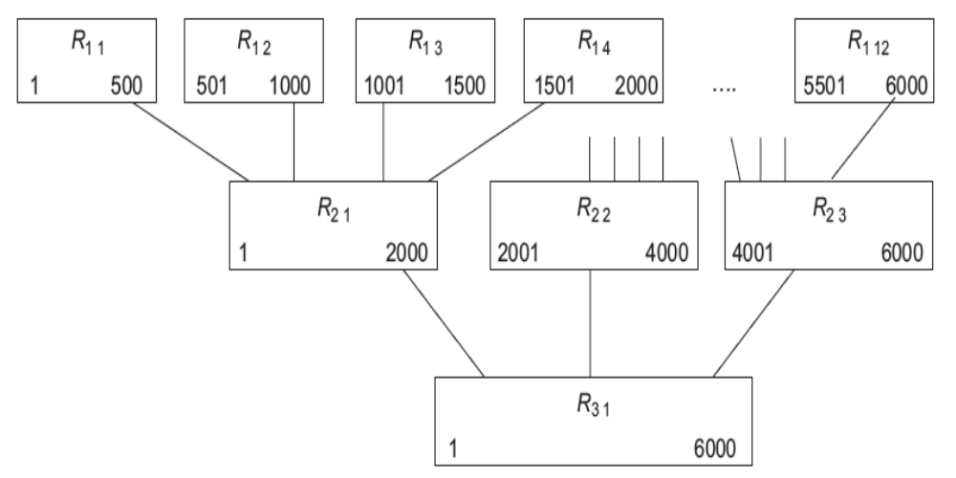
4-WAY MERGE SORT
K. Govindaraju, Associate Professor

Slide 12
Example: 2- way merge sort
Consider 6000 records are available on a disk which are to be sorted. In the internal memory of the computer, only 500 records can be resided. The block size of the disk is 100 records. Sort the file using 2-way merge sort.
Solution: The steps involved in sorting the file are as follows:
  Step 1: Read five blocks of data i.e. totally 500 records at a time from the file residing on the disk to internal memory. Sort these blocks using any internal sorting technique to generate 12 runs (runs = 6000 records / 500 records). These runs are written back on to the disk after sorting.
  Step 2: Merge 2 runs at a time to generate a new run in the next pass with size twice as long.
  Until all runs in the pass are processed
  Step 3: Repeat Step 2 until a single run is generated.
  Step 4: EXIT
K. Govindaraju, Associate Professor

Slide 13
Example: Perform 2-way merge sort
81
94
96
11
12
35
99
17
28
58
41
75
15
Unsorted Data on Disk
Assume k = 2 First step is to read 2 data items at a time into main memory, sort them and write them back to disk as runs of length 2. The initial blocks are
81
94
96
11
12
35
99
17
28
58
41
75
15
K. Govindaraju, Associate Professor

Slide 14
After internal sort, the runs are
81
94
11
96
12
35
17
99
28
58
41
75
15
Merge the runs of length 2 into runs of length 4. After merging & sorting, the runs are
11
81
94
96
12
17
35
99
28
41
58
75
15
K. Govindaraju, Associate Professor

Slide 15
Next step is to merge the runs of length 4 into runs of length 8.
11
12
17
35
81
94
96
99
15
28
41
58
75
Next step is to merge the runs of length 8 into runs of length 16. The final sorted run is
11
12
15
17
28
35
41
58
75
81
94
96
99
K. Govindaraju, Associate Professor

Slide 16
k-Way_mergesort( File1, M, k)
File1 – unsorted file on disk
M –max records that can be stored & sorted in internal memory at a time
k – number of runs to be merged
Step 1: Run Generation
Repeat until all records in File1 are processed into runs
Read M records into main memory & sort internally.
Write this sorted sub-list (run) onto disk.
[END OF LOOP]
Step 2: Merging of Runs
Repeat until all runs are processed
Merge k runs into one sorted run with size as k times the input run size
Write this single run back onto disk
[END OF LOOP]
Step 3: If more than 1 run is generated in Step 2 then
Repeat Step 2
Else
The file on the external storage is sorted
Step 4: EXIT
K. Govindaraju, Associate Professor

Slide 17
Merging Runs - Implementation
The k-Way merge sort includes merging of runs in every pass.
The simplest merging technique is the k-way merge, where k runs are merged into one run.
The merging process includes the following steps.
Identify the first smallest record of each run and place it in the smallest set.
The smallest of the records in the smallest set is the smallest record overall. This record is put in the output run and removed from the corresponding run.
The next smallest record in the corresponding run is moved to the smallest set.
This process is repeated until the initial runs are empty.
K. Govindaraju, Associate Professor

Slide 18
Example:
Consider 3 runs with 4 records each. Show the merging process in the 3-way merge sort
Run1 - 3 ,5 , 12, 15
Run2 - 2, 4, 10, 17
Run3 - 1, 6, 8, 18
Output Run – 1, 2, 3, 4, 5, 6, 8, 10, 12, 15, 17 18
Solution: The step by step process of merging includes
Consider the smallest record of each run and add it to the smallest set: {3, 2, 1}
K. Govindaraju, Associate Professor

Slide 19
Step 1: The three records in the smallest set are {3, 2, 1}. Remove the smallest record 1, from the third run and put it in the output run: {1}. Move 6 to the smallest set.
Step 2: The three records in smallest set are {3, 2, 6}. Remove 2 from the second run. output run: {1, 2}. Move 4 to the smallest set.
Step 3: smallest set is {3, 4, 6}. Remove 3 from the first run.
output run: {1, 2, 3}. Move 5 to the smallest set.
Step 4: smallest set is {5, 4, 6}. Remove 4 from the second run.
output run: {1, 2, 3, 4}. Move 10 to the smallest set.
Step 5: smallest set is {5, 10, 6}. Remove 5 from the first run.
output run: {1, 2, 3, 4, 5}. Move 12 to the smallest set.
Step 6: smallest set is {12, 10, 6}. Remove 6 from the third run.
output run: {1, 2, 3, 4, 5,6}. Move 8 to the smallest set.
K. Govindaraju, Associate Professor

Slide 20
Step 7: smallest set is {12, 10, 8}. Remove 8 from the third run.
output run: {1, 2, 3, 4, 5, 6, 8}. Move 18 to the smallest set.
Step 8: smallest set is {12, 10, 18}. Remove 10 from the second run.
output run: {1, 2, 3, 4, 5, 6, 8, 10}. Move 17 to the smallest set.
Step 9: smallest set is {12, 17, 18}. Remove 12 from the first run.
output run: {1, 2, 3, 4, 5, 6, 8, 10, 12}. Move 15 to the smallest set.
Step 10: smallest set is {15, 17, 18}. Remove 15 from the first run.
output run: {1, 2, 3, 4, 5, 6, 8, 10, 12, 15}.The first run is empty, the merge
follows as a 2-way merge instead of a 3-way merge.
Step 11: smallest set is {17, 18}. Remove 17 from the second run . The output run: {1, 2, 3, 4, 5, 6, 8, 10, 12, 15, 17}. Now, the second run is also empty, only the third run remains non-empty.
Step 12: smallest set is {18}. Remove 18 and append to the output run.
The result of merging the three initial runs is {1, 2, 3, 4, 5, 6, 8, 10, 12, 15, 17, 18}.
K. Govindaraju, Associate Professor

Slide 21
Buffer handling for parallel operations
In k-way Merge sorting technique, we need atleast
k-input buffers and 1-output buffer
The major steps involved in the k-way Merge sort are:
Read: Load the records from Runs into input buffers
Merge: Perform Merge on input buffers & store result in output buffer
Write: Store the records from the output buffer onto the Disk.
Instead of performing these operations in serial, performing these operations in parallel improves the efficiency,
i.e. we can perform Read, Merge and Write operations simultaneously.
But k-input buffers and 1-output buffer strategy is not sufficient to handle the parallel operations.
We require 2k-input buffers(read & merge) and 2-output buffers(merge & write) to handle the operations in parallel.
K. Govindaraju, Associate Professor

Slide 22
Buffer handling for parallel operations
Using buffer handling for parallel operations, implement 2-way merge for the runs shown below.
Let block size= 2 and each buffer can hold 2 records.
As 2-way merge is to be used, the input buffers used are 4 and the output buffers used are 2.
Let in[1],in[2] represent the input buffers for loading the records from Run1 and in[3],in[4] represent the input buffers for loading the records from Run2.
Let ou[0] and ou[1] represent the output buffers.
Initially all the input and output buffers are empty.
The steps involved are
2 | 4 | 6 | 8 | 9 | 10
3 | 5 | 7 | 16 | 21 | 26
Run1
Run2
K. Govindaraju, Associate Professor

Slide 23
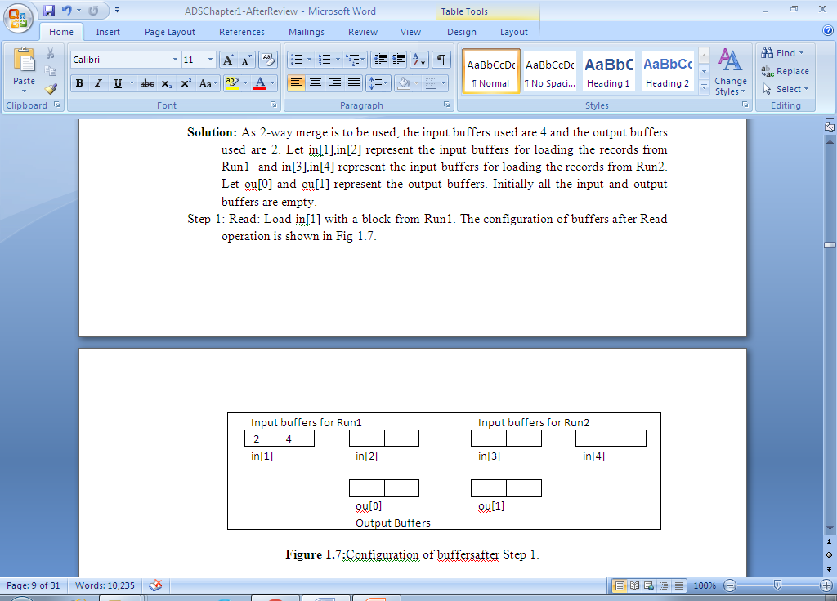
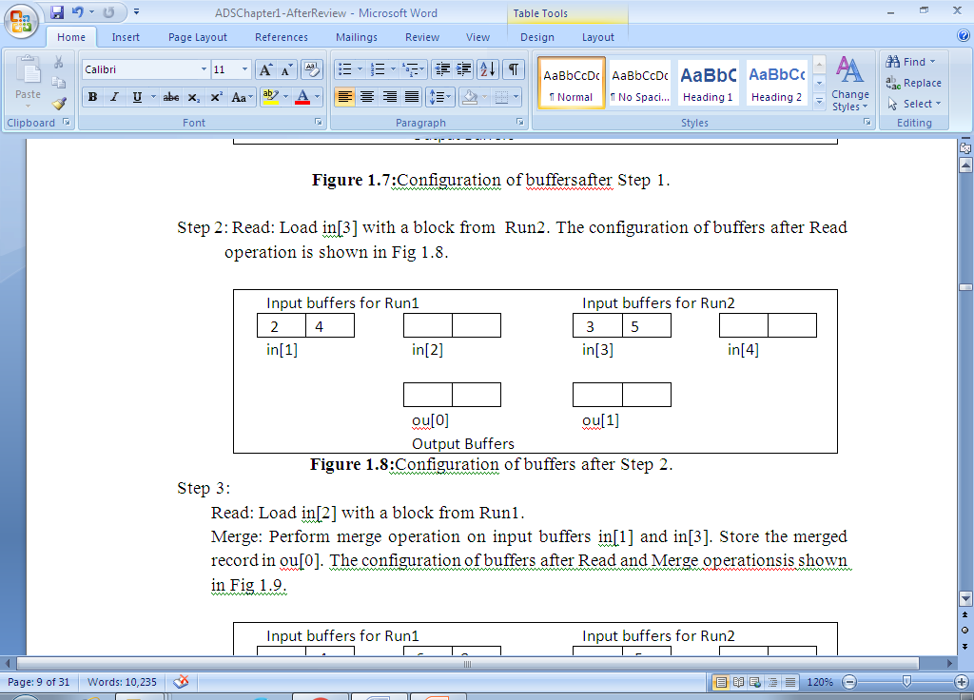
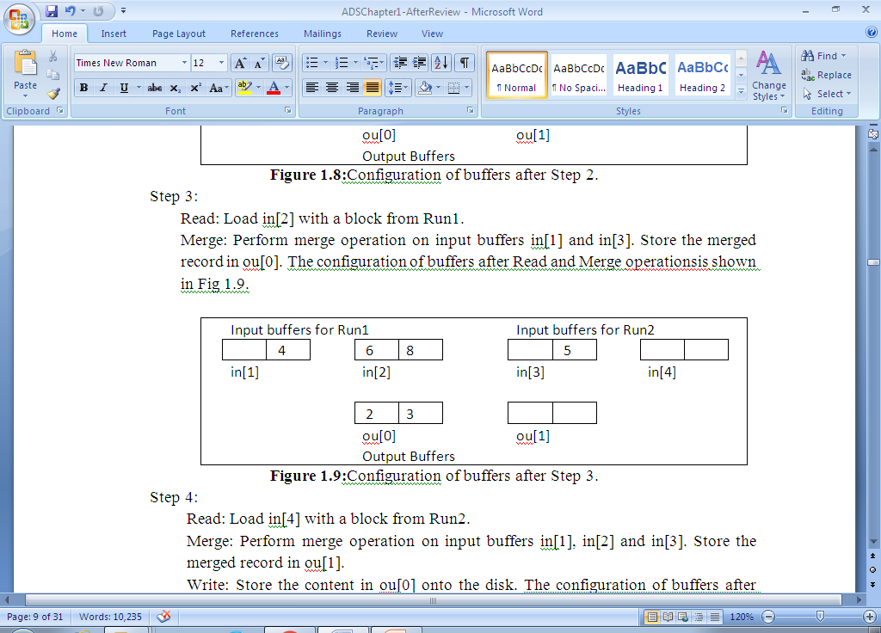
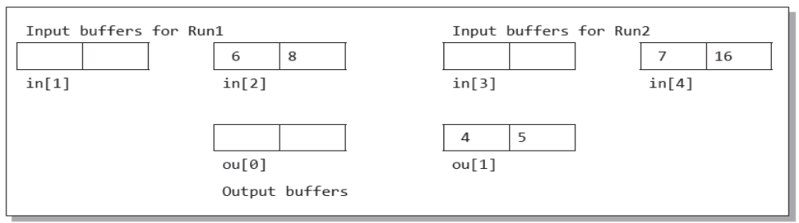
step1
step2
step3
step4
K. Govindaraju, Associate Professor

Slide 24
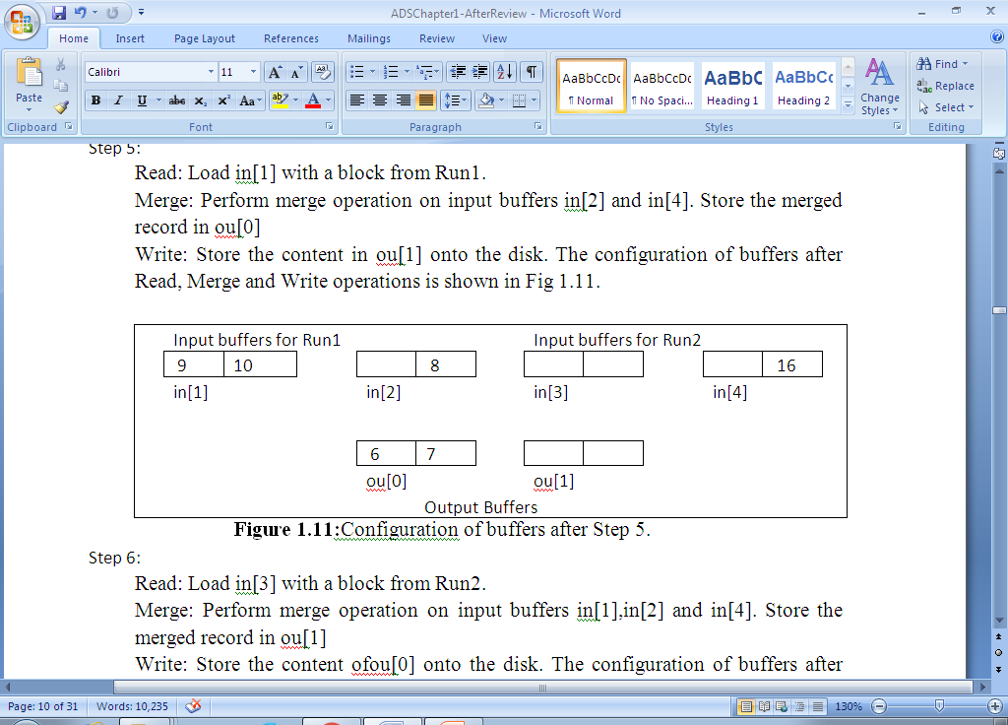
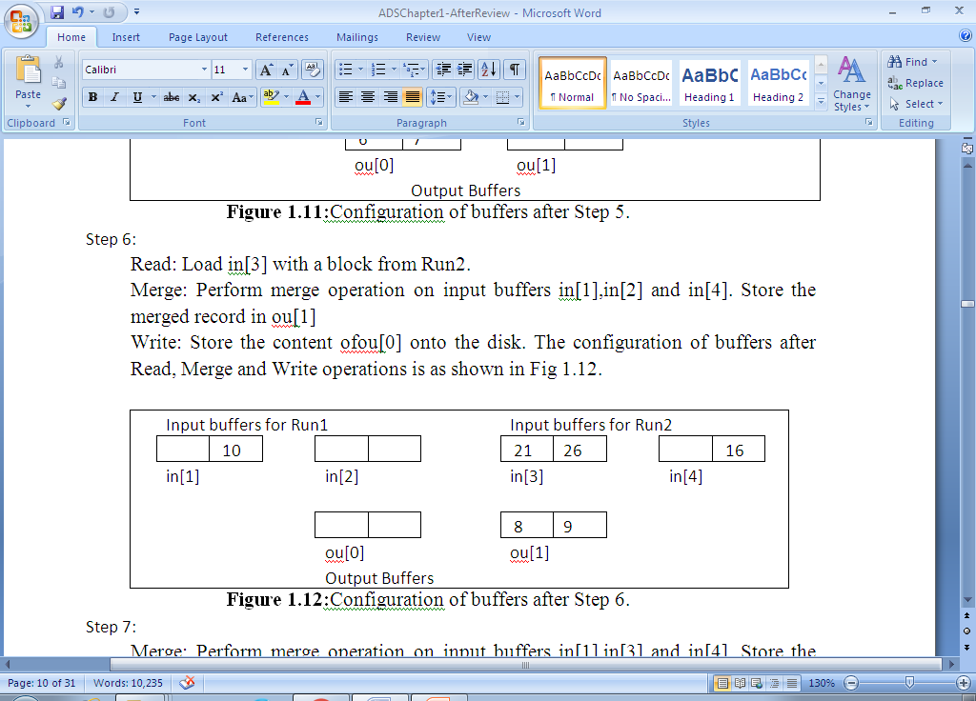
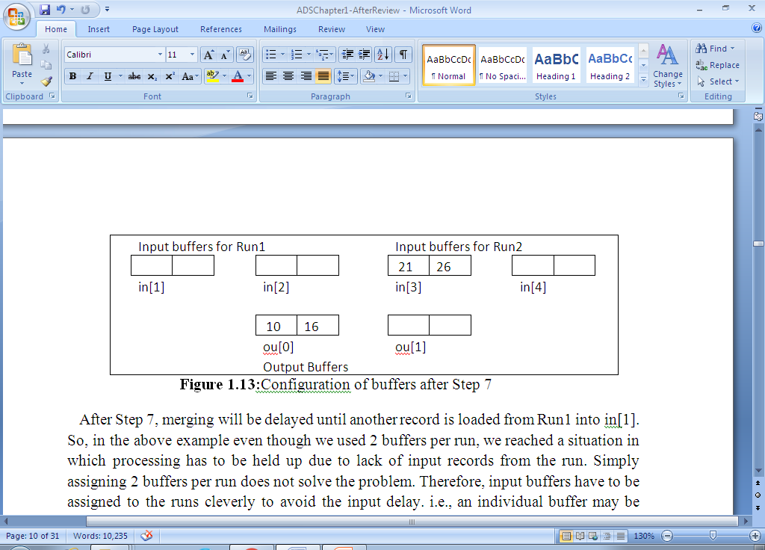
step5
step6
step7
K. Govindaraju, Associate Professor

Slide 25
After Step 7, merging will be delayed until another record is loaded from Run1 into in[1].
Processing has to be held up due to lack of input records from the run. Simply assigning 2 buffers per run does not solve the problem. Therefore, input buffers have to be assigned to the runs cleverly to avoid the input delay,
An individual buffer may be assigned to any run depending upon need. This type of buffer that is assigned to a run when needed is called a floating buffer and the k–way merge algorithm using floating buffers is called buffering algorithm.
In the buffer assignment strategy of floating buffers, at any time there will be at least one input buffer for each run. The remaining buffers will be filled on a priority basis.
K. Govindaraju, Associate Professor

Slide 26
The following assumptions are made for buffering algorithm
For performing “read” and “write” onto a disk simultaneously, we take two disk drives.
While read or write operation is being processed, the CPU cannot make reference to the same block of memory.
Input and output buffers are of the same size.
End of each run has a sentinel record with a very large key, say +∞ and all other records have key value less than that of sentinel record.
The time to merge into an output buffer equals the time to read a block.
In case of equal keys, the run with smallest index is chosen for the next read operation.
Input buffers are queued in k queues, one queue for each run. Empty buffers are placed on a linked stack.
K. Govindaraju, Associate Professor

Slide 27
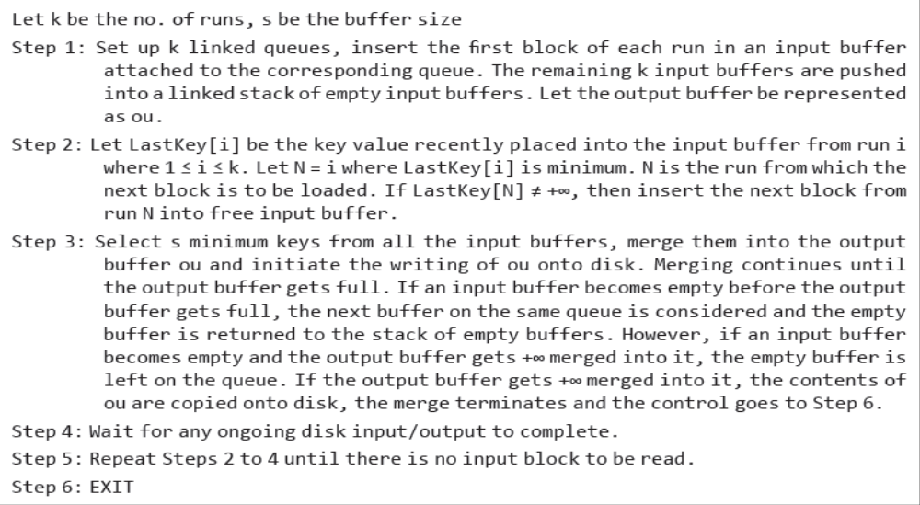
k-way merge using floating buffers
K. Govindaraju, Associate Professor

Slide 28
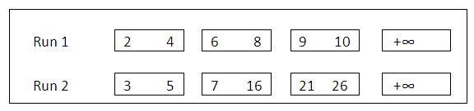
2-way merge with floating buffers
Implement k-Way merge with floating buffers for the runs shown below. Assume that the last block of each run is loaded with the sentinel record with key +∞. The blocks in Run1 and Run2 are as follows:
K. Govindaraju, Associate Professor

Slide 29
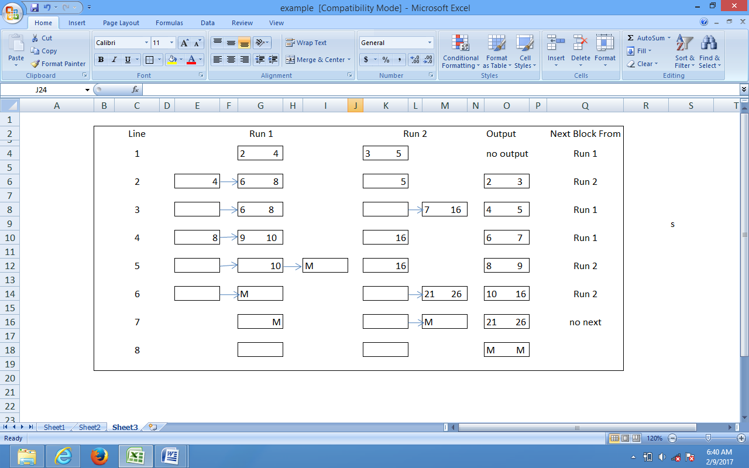
2-way merge with floating buffers
K. Govindaraju, Associate Professor

Slide 30
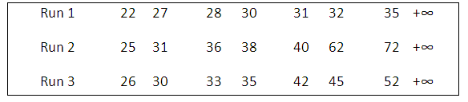
3-way merge with floating buffers
Implement k-Way merge with floating buffers for the runs shown below. Assume that the last block of each run is loaded with the sentinel record with key +∞. The blocks in Run1, Run2 and Run3 are as follows:
K. Govindaraju, Associate Professor

Slide 31
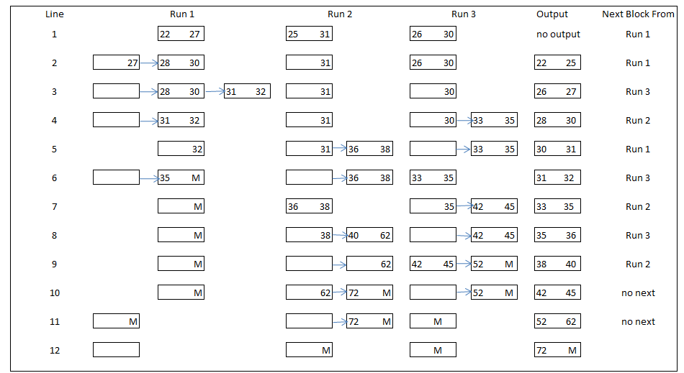
3-way merge with floating buffers
K. Govindaraju, Associate Professor

Slide 32
MERGING OF RUNS USING TOURNMENT TREES
Using internal sorting techniques, it is possible to generate runs whose size = internal memory.
But, by using the loser’s tree, it can be performed in a better way.
A loser tree can be understood clearly by knowing firstly about Winner trees.
A winner tree is a complete binary tree where each internal node represents the smaller of its two children.
The root consists of the smallest value in the entire tree.
As like a tournament tree, each internal node of the winner tree represents the winner(smallest) of a tournament and the root node is the overall winner(overall smallest) of the entire tournament.
The keys or records are present in the external nodes or leaf nodes only.
K. Govindaraju, Associate Professor

Slide 33
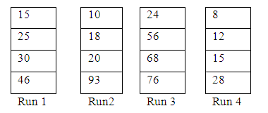
Example - Consider merging of 4 runs using Winner tree and Loser tree for the Runs shown below.
K. Govindaraju, Associate Professor

Slide 34
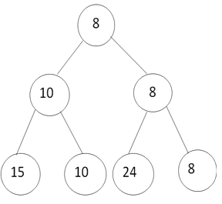
Winner tree
The first key of each run is initially loaded into the external nodes of the winner tree.
Comparison takes place at every level of the tree, starting from the leaf nodes towards the root.
The internal nodes 10 and 8 represent the winner of the respective tournaments played between 15, 10 and 24, 8 respectively.
The root node of the winner tree consists of the overall winner i.e., 8.
This value pointed by root is stored onto the disk.
K. Govindaraju, Associate Professor

Slide 35
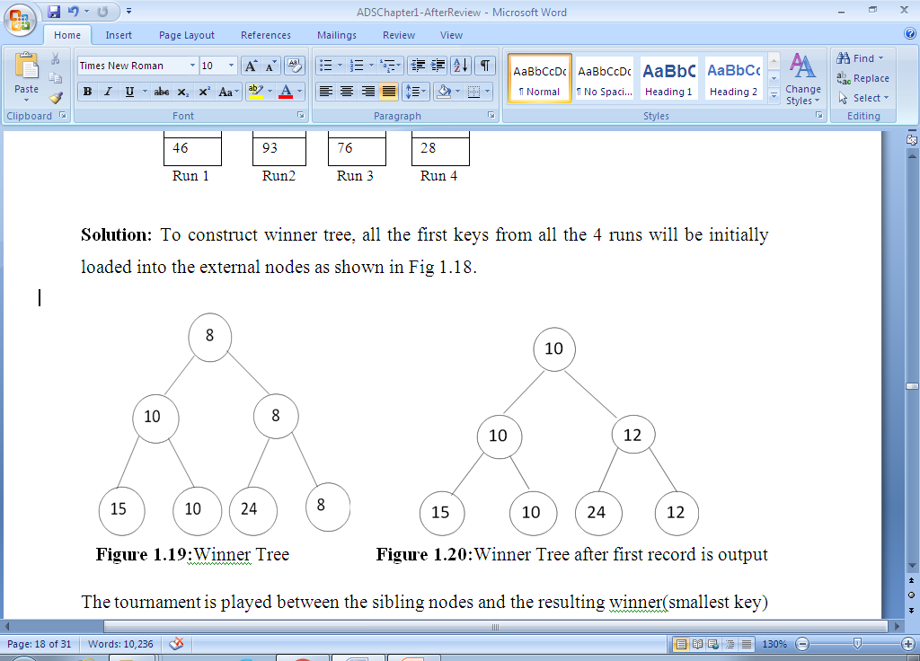
Winner Tree after first record is output
When a record is output in the Winner tree, the next record to be placed in the external node is taken from the run from which the smallest record is output in the previous pass
The smallest record at root i.e 8 is taken from Run 4. So, the next value that is input is to be taken from Run4.
The next value in Run4 to be input is 12.
The value 12 is compared against the other values which are basically the losers in the previous pass.
The overall winner 10, is stored onto disk.
The process repeats until all the elements from the runs are processed.
K. Govindaraju, Associate Professor

Slide 36
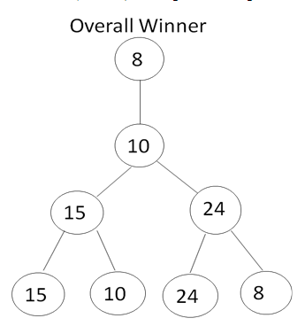
Loser tree
Another efficient way of generating runs is by using Loser trees in which the number of comparisons are reduced.
The winner tree can be restructured in such a way that instead of placing pointers to winners as internal nodes, pointers to losers can be placed as internal nodes. Such trees are called as Loser trees.
The root node consists of the loser of the winner nodes in the previous level.
A special node is added on top of the root node to represent the overall winner of the tournament.
The leaf nodes of Loser tree consist of the first records of all the runs as in Winner tree.
K. Govindaraju, Associate Professor

Slide 37
Loser tree
In the first step, the overall winner is the output and therefore the value 8 is copied onto the disk.
The next value is to be considered from Run 4 as the output value 8 is from Run 4.
The value to be input is now 12.
This is copied into the leaf nodes. But once the overall winner is output, the records with which the input needs to play these tournaments are readily available in the parent nodes.
As a result, the sibling nodes are not accessed when the tournaments are being played.
K. Govindaraju, Associate Professor

Slide 38

Loser Tree after the first record is output
In the Loser tree after the first record is outputted the value 12 in leaf node is compared with its parent 24 and not compared with its sibling 24.
The root node consists of loser of the nodes 10 and 12 i.e 12.
The overall winner consists of the winner of 10 and 12 (i.e. 10).
The process repeats until all the elements from the runs are processed.
K. Govindaraju, Associate Professor

Slide 39
Optimal Merging of Runs ( with different sizes)
When runs of different sizes are to be merged, the process of merging is challenging and the main question is how the merging can be optimized.
For merging the runs with different sizes, a merge tree is used.
A merge tree is a tree constructed by merging the runs of different sizes.
In a merge tree, the circular node is called as internal node and the square node is called as external node which is used to represent the initial runs.
The possible ways of merging the runs of different sizes can be demonstrated clearly by considering an example of four runs of length 3,6,8 and 14 respectively.
The runs are merged in two different ways using 2-way merge.
K. Govindaraju, Associate Professor

Slide 40
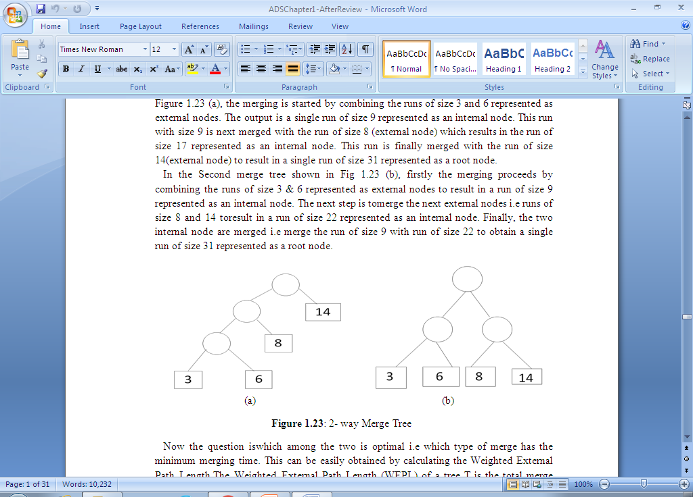
CASE 1: The merging is started by combining the runs of size 3 and 6 represented as external nodes. The output is a single run of size 9 represented as an internal node.
This run with size 9 is next merged with the run of size 8 (external node) which results in the run of size 17 represented as an internal node.
This run is finally merged with the run of size 14(external node) to result in a single run of size 31 represented as a root node.
K. Govindaraju, Associate Professor

Slide 41
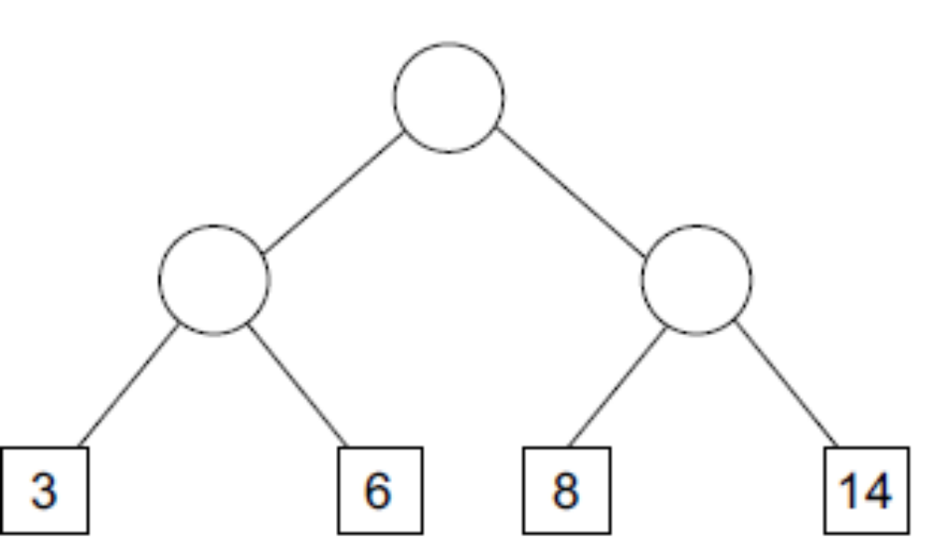
CASE 2: The merging proceeds by combining the runs of size 3 & 6 represented as external nodes to result in a run of size 9 represented as an internal node.
The next step is to merge the next external nodes i.e runs of size 8 and 14 to result in a run of size 22 represented as an internal node.
Finally, the two internal node are merged i.e merge the run of size 9 with run of size 22 to obtain a single run of size 31 represented as a root node.
K. Govindaraju, Associate Professor

Slide 42
Optimal Merging of Runs
Now the question is which among the two is optimal
i.e which type of merge has the minimum merging time.
This can be easily obtained by calculating the Weighted External Path Length.
The Weighted External Path Length (WEPL) of a tree T is the total merge time calculated by adding the product of weight of an external node and the depth of the external node from the root node.
The weight of the external node is the run size.
The depth of the external node is the length of the path from the root node to the external node.
The WEPL can be calculated using the equation
WEPL(T) = ∑(weight of external node i)* (depth of node i from the root)
K. Govindaraju, Associate Professor

Slide 43
WEPL(T) = S(weight of external node i) * (depth of node i from the root)
For the CASE 1 Figure ,
WEPL(T) = 3 * 3 + 6*3 + 8*2 + 14*1
= 57
For the CASE 2 Figure ,
WEPL(T) = 3*2+6*2+8*2+14*2
= 62
We observe that CASE 1 Fig. has minimum WEPL. Therefore, the merging technique followed in CASE 1 Fig. is considered as optimal merge.
K. Govindaraju, Associate Professor

Slide 44
Huffman code
Another way of finding a binary tree with minimum WEPL is by using Huffman Code.
Consider the messages M₁,M₂........M_{n+1} for which we have to derive the optimal set of codes.
Each code is binary string used for transmission of messages.
At the receiver end, the code is decoded using a decode tree, which is a binary tree, where the external nodes represent the messages.
The binary bits in the code of a message determine the branching needed at each level to reach the correct external node.
K. Govindaraju, Associate Professor

Slide 45
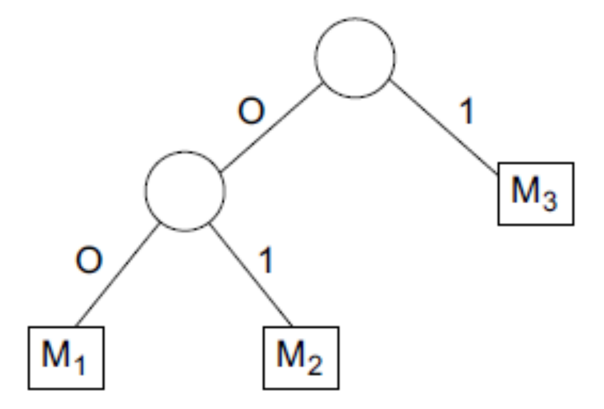
Let ‘0’ represent a left branch and ‘1’ represent a right branch of the decode tree.
The codes 00, 01 and 1 represent the messages M₁, M₂ and M₃ respectively. These codes are called as Huffman codes.
The size of message Mi is directly proportional to the number of bits in the code and the cost of decoding the code word is same as WEPL.
The decoding time can be minimized by constructing a decode tree with minimum WEPL.
Huffman constructed a Binary tree with minimum weighted external path length called the Huffman tree.
The Huffman Algorithm is applied for constructing the Huffman tree.
K. Govindaraju, Associate Professor

Slide 46
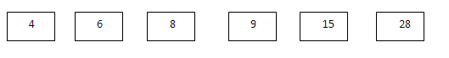
Huffman tree
The two main activities done using the Huffman Algorithm are constructing a Huffman tree and finding the Huffman codes by traversing the nodes from root to leaf nodes in the Huffman tree.
In the Huffman tree, the leaf nodes represent the characters and the internal nodes represent the intermediary values.
Example : Consider six characters q1 to q6 with the following values for each node.
q1 = 4, q2 = 6, q3 = 8, q4 = 9, q5 = 15, q6 = 28. Construct a Huffman tree and find the code for each character.
Step 1: create leaf nodes
K. Govindaraju, Associate Professor

Slide 47

Step 2: Step 3:
Select 2 min nodes from the given character list. q1 and q2 values are minimum. Construct a Huffman tree with q1 as left child and q2 as right child. Calculate the internal node value i.e., 10. Replace q1 and q2 in the list with this value 10. The list now contains 10 (internal node value), q3 = 8, q4 = 9, q5 = 15, and q6 = 28.
Consider the next 2 min nodes from the list. q3 and q4 are minimum. Construct a tree with q3 as left child and q4 as right child. Create an internal node with value 17 . Replace q3 and q4 in the list with this value 17. The list now contains 10, 17, q5 = 15, and q6 = 28.
K. Govindaraju, Associate Professor

Slide 48
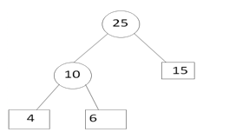
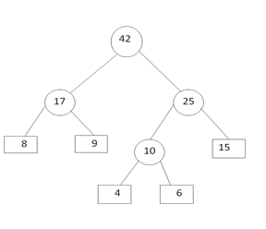
Step 4: Step 5:
Consider the next 2 min nodes from the list. The values 10 and q5 are minimum. Construct the tree with the internal node 10 as left child and q5 as right child. Create an internal node with value 25. Replace 10 and q5 in the list with this value 25. The list now contains 17, 25, and q6 = 28.
Consider the next 2 min nodes from the list. The values 17 and 25 are minimum. Construct the tree with the internal node 17 as left child and 25 as right child. Create an internal node with value as 42 . Replace 17 and 25 in the list with this value 42. The list now contains, 42 and q6 = 28.
K. Govindaraju, Associate Professor

Slide 49
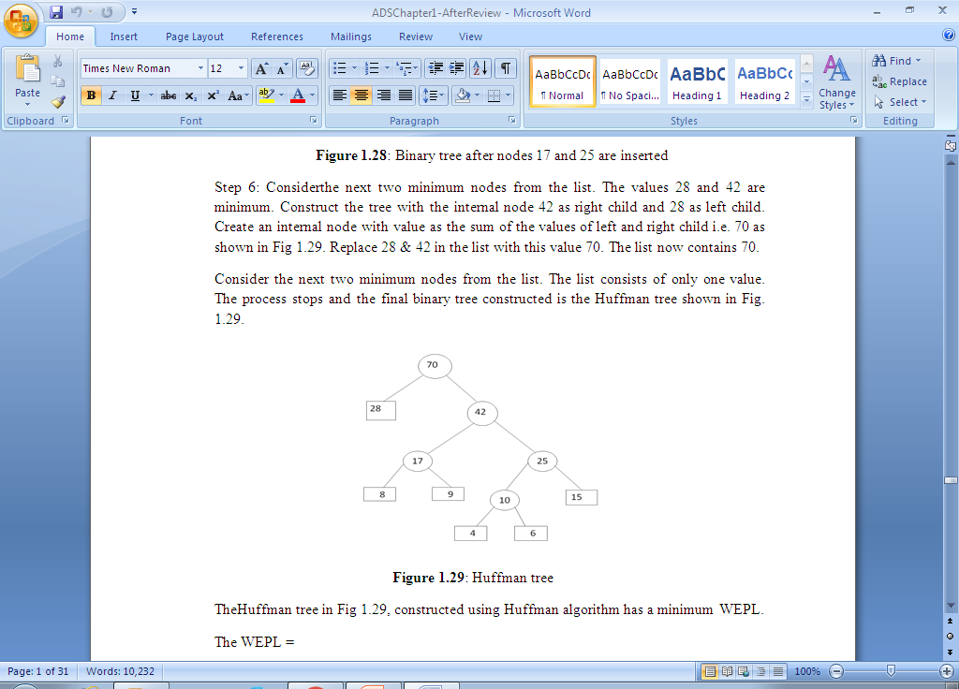
Huffman tree
Step 6:
Construct the tree with the internal node 42 as right child and 28 as left child. Create an internal node with value as the sum of the values of left and right child i.e. 70
Consider the next two minimum nodes from the list. The list consists of only one value. The process stops and the final binary tree constructed is the Huffman tree
K. Govindaraju, Associate Professor

Slide 50
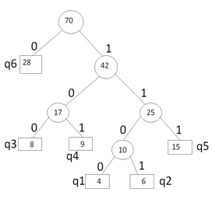
Huffman tree with codes
Considering ‘0’ represents the left child and ‘1’ represents the right child of the Huffman tree , the Huffman Code for each of the character is known by traversing the Huffman tree from the root node to the character leaf node. The Huffman codes are q1= 1100, q2 =1101, q3=100, q4= 101 , q5=111, q6= 0.
K. Govindaraju, Associate Professor

Slide 51
Algorithm for constructing Huffman tree
Step 1: Use the given characters in the list and create a leaf node for each character.
Step 2: Select two nodes with minimum values in the given list of characters.
Step 3: Construct a binary tree by creating a new internal node with value as the sum of two minimum values from the list. The minimum value of the list is considered as a left child and the next minimum value is considered as a right child. Replace the two nodes selected in the list with the internal node value.
Step 4: Repeat Steps2 & 3 until the list has only one value.
Step 5: EXIT
K. Govindaraju, Associate Professor

Slide 52
  Thank You
K. Govindaraju, Associate Professor

